Slide 1
Homework

Slide 2
Introduction
You should expect to get one homework assignment each week
Homework demo on Saturdays during office hours

Slide 3
Where to find your homework
GitLab
https://birmingham.bootcampcontent.com/dashboard/projects

Slide 4
Homework Scenarios
On-the-job tickets (contains starter code)
Job-seeking coding assessments (does not contain starter code and you will build your app from scratch)

Slide 5
Agile Project management
User story - describes application using non-technical language
Acceptance criteria -- make sure you meet all to complete your assignment
Review - Review is conducted by the TA’s (Paul)

Slide 6
Where to submit your Homework
Submit your homework in BootCampSpot
https://bootcampspot.com/
You are required to provide two urls
Url of your deployed application (Heroku) - will be covered on Monday!
The Url of your gitHub repository where your code resides.
Include a well-written ReadMe file.

Slide 7
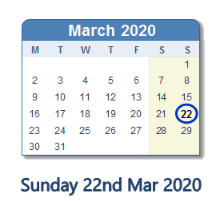
Homework Due Date
Use BootcampSpot to check dues dates!!!

Slide 8
Homework Demo

Slide 9
Questions?

